Slide 1

BREAST CANCER
Statistical Analysis and Predictive Modeling for Survival in Patients with Malignant Breast Tumors
Emiliano Rosales
Haillet Rivero
Rodrigo Nava

Slide 2
Summary
This project explores treatment success in 1904 patients from data collected at the Cambridge Research Institute. We begin by presenting descriptive statistics of the analyzed population using Tableau for visual representation. Utilizing a highly accurate machine learning model, we provide users with the ability to predict the survival rates of patients. To broaden the application of our model to the general population, we developed a second model that, while slightly less accurate, allows users to estimate their survival rates using more accessible information. The results are conveniently accessible through a website for user-friendly utilization.

Slide 3
Predict breast cancer survival using machine learning models
The most important part of a process of clinical decision-making in patients with cancers, in general, is the accurate estimation of prognosis and survival duration. Breast cancer patients with the same stage of the disease and the same clinical characteristics can have different treatment responses and overall survival.

Slide 4
Deep learning model predictions
Model: Neural Networks
Variable aimed to predict:
Overall survival
Features of the model:
Age at Diagnosis,
Type of Cancer,
Tumor Detailed information about the tumor, including size, stage, and grade.
Treatment procedure,
Overall Survival rate
Genetics attributes

Slide 5
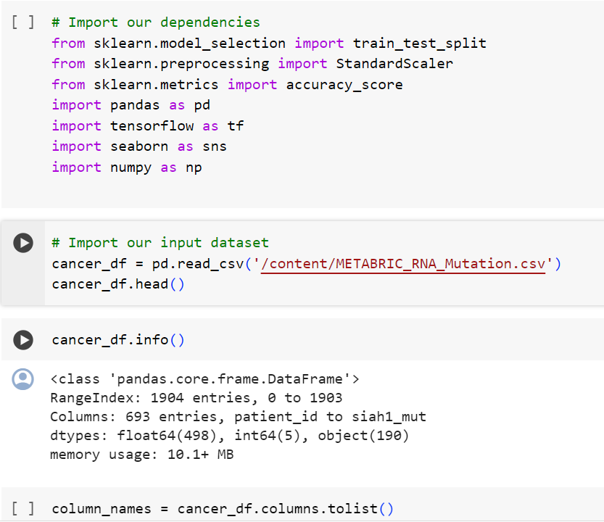
Read and clean the data

Slide 6
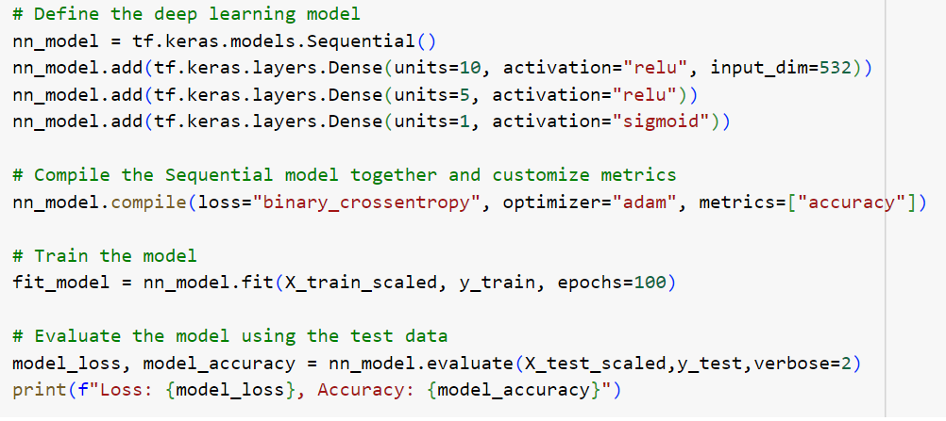
Creating a neural network model by assigning the number of input features and nodes for each layer using TensorFlow and Keras

Slide 7
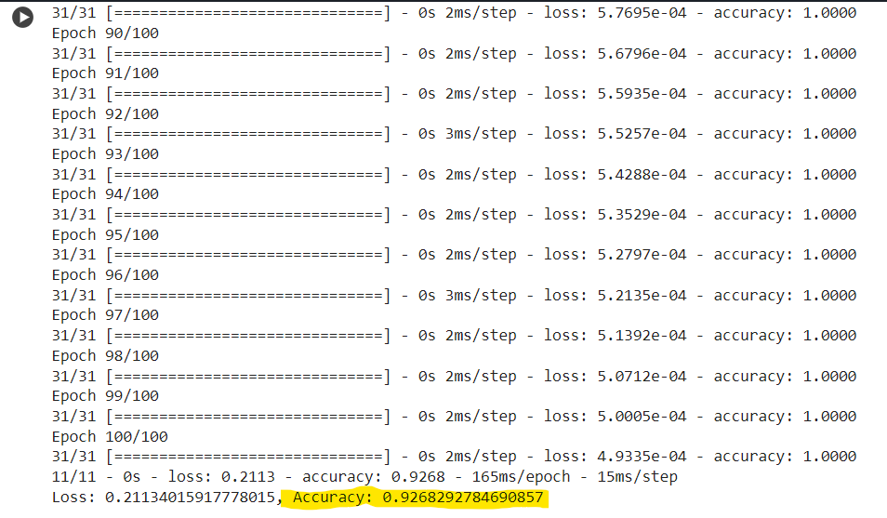
Evaluate the model’s performance by generating an accuracy score.

Slide 8
Results
* 1st model attempt:
layers: 2
neurons: 15
activation function: 'relu'
epochs: 100
model performance: 0.93 (accuracy)

Slide 9
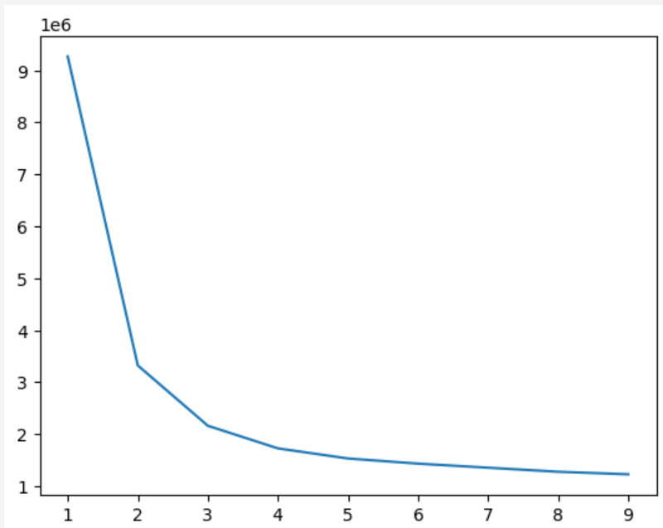
Gene clustering

Slide 10
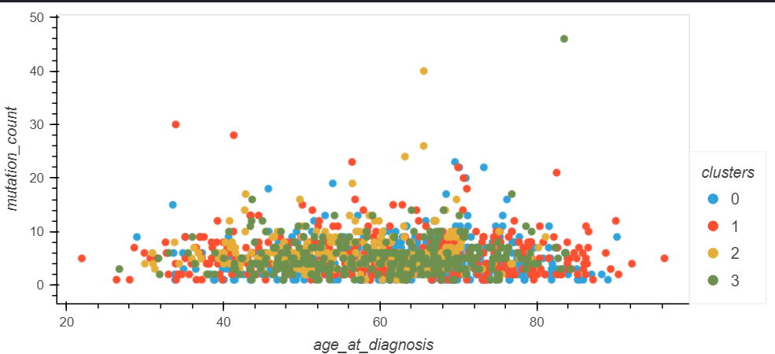
Gene clustering

Slide 11
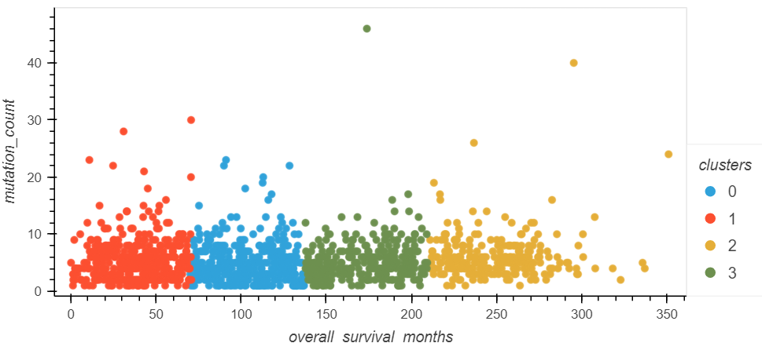
Gene clustering

Slide 12
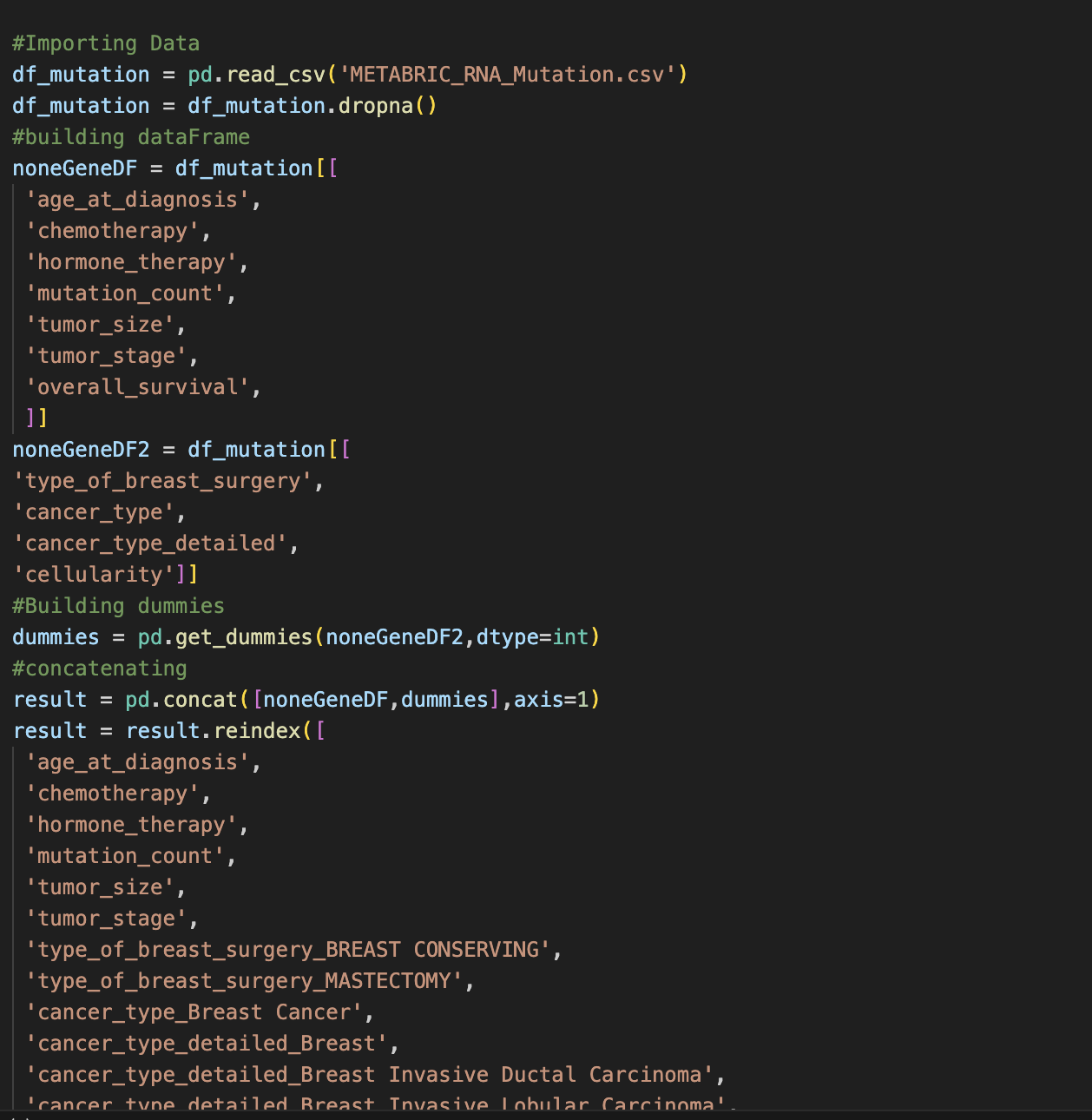
Flask application
To create a user-model interaction, we implemented an html python connection using flask, first following the ETL process, We extract the data from the CSV and proceed to clean and transform it.

Slide 13
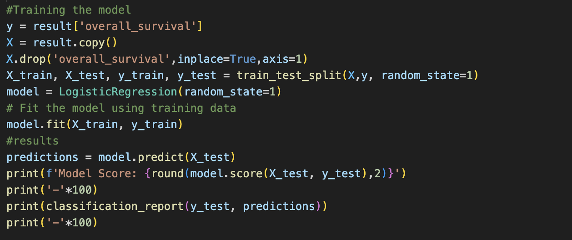
Flask application
Then we proceed to the model training using a logistic regression, also printing in the console the model score

Slide 14
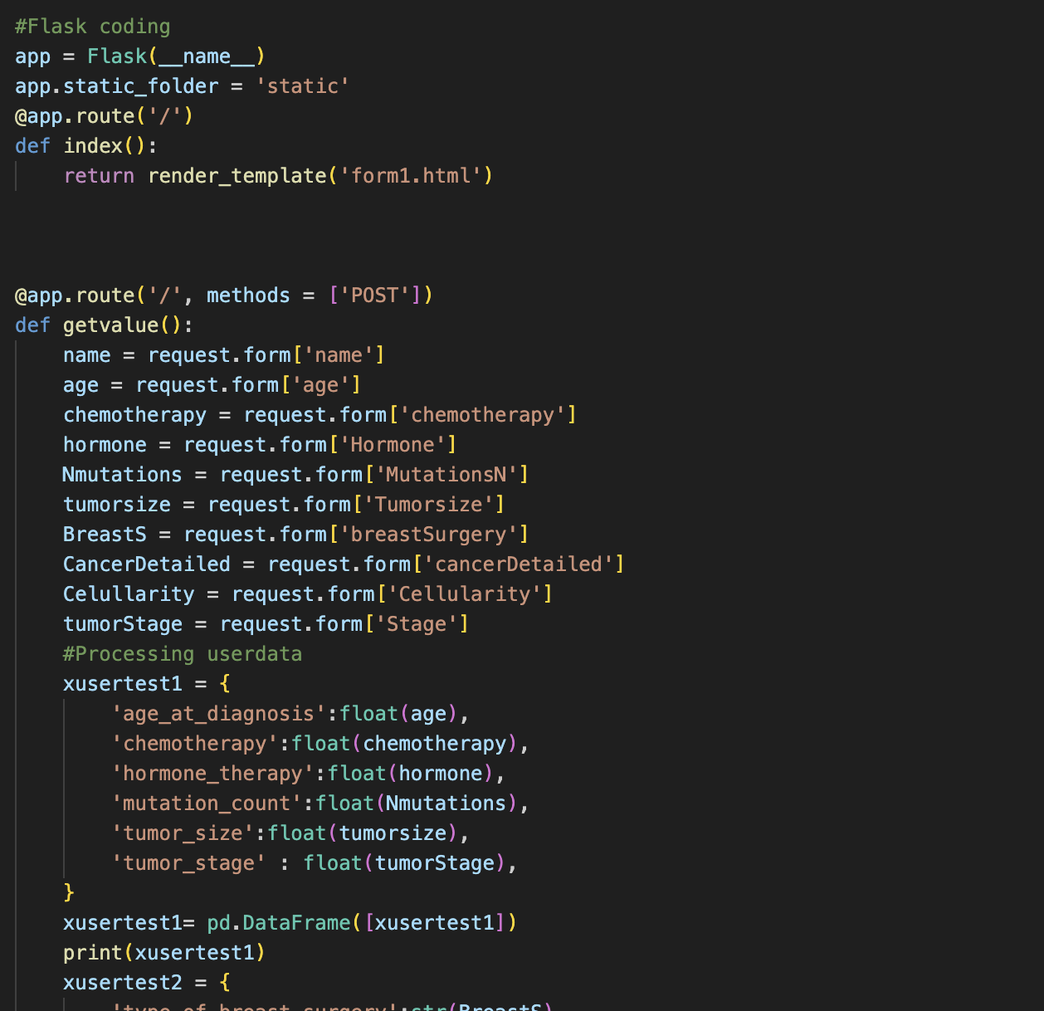
Flask application
Once model trained, we proceed collecting data from user, we achive so by implementing a form and requesting with flask those results.

Slide 15
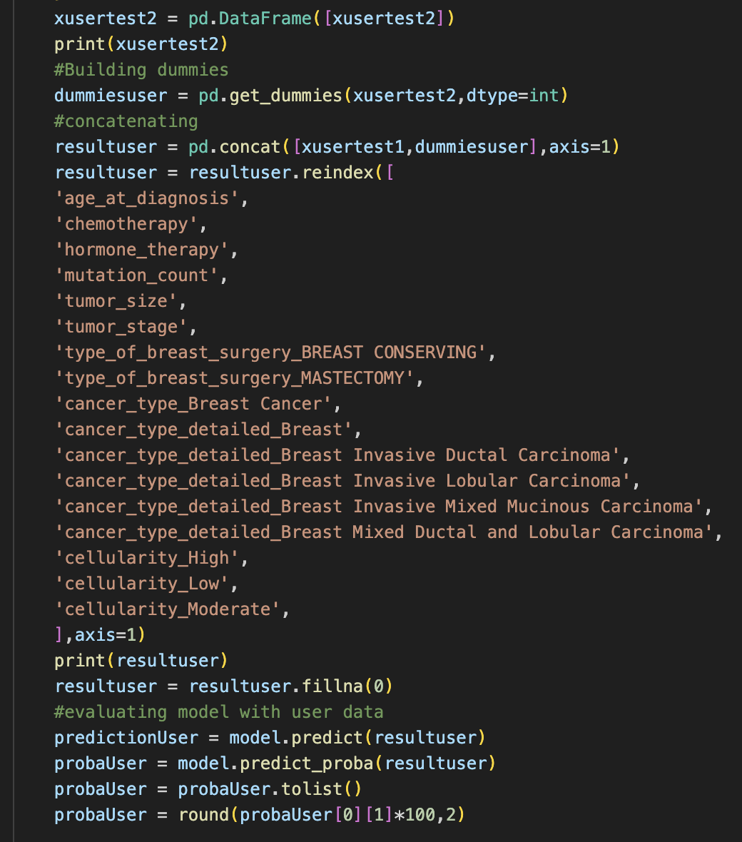
Flask application
Finally we transform the data provided by the user to feed the model and make a prediction

Slide 16
CONCLUSION
Cancers are associated with genetic abnormalities. Gene expression measures the level of gene activity in a tissue and gives information about its complex activities. Using machine learning techniques on genetic data has the potentials of giving the correct estimation of survival time and can prevent unnecessary surgical and treatment procedures.

